Slide 1
VIT – AP UNIVERSITY SCHOOL OF COMPUTER SCIENCE AND ENGINEERING STORAGE TECHNOLOGY AND MANAGEMENT (SWE2005) COURSE INTRODUCTION Dr. G. MUNEESWARI PROFESSOR

Slide 2

Course Information
Number of Credits : 3 Credits / 6 Hrs per week
Theory Oriented Course
Contact Hours : 45 Hrs
Course Instructor : Dr.G.Muneeswari
E-Mail : muneeswari.g@vitap.ac.in
Contact : 7904846254

Slide 3
Course Objectives
To provide a comprehensive understanding of the varied storage infrastructure components in classic and virtual environments.
To understand the concepts of Storage infrastructure management processes, Storage Area Network (SAN) and Network Attached Storage (NAS).
To study the Business continuity and Storage security.

Slide 4
Course Outcomes
Evaluate storage architectures and key data center elements in classic, virtualized and cloud environments.
Explain physical and logical components of a storage infrastructure including storage subsystems, RAID and intelligent storage systems.
Articulate business continuity solutions – backup and replication, plus archive for managing fixed content.
Managing and monitoring storage infrastructure in classic, virtualized and cloud environments

Slide 5
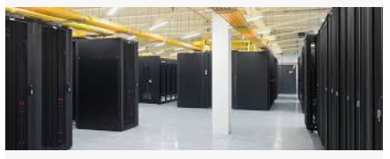
Module-1 (Introduction to Storage Technology) – 7 Hrs
Information Storage- Evolution of Storage Technology and Architecture- Data Center Infrastructure- Key Challenges and Information Life cycle - Components of a Storage System Environment

Slide 6
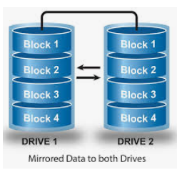
Module-2 (RAID) – 7 Hrs
Introduction to RAID-Implementation of RAID- RAID Array and Components - RAID Levels- Compare and contrast integrated and modular storage systems- Intelligent Storage System

Slide 7
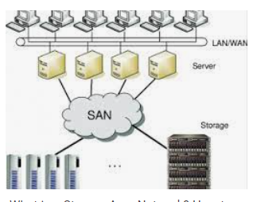
Module-3 (Storage Networking Technologies) – 8 Hrs
Direct-Attached Storage(DAS) - Introduction to SCSI – Storage Area Network(SAN) : Evolution & Components – Fibre Channel Connectivity, Ports, Architecture, Zoning, Fibre Channel Login Types and Topology - Network-Attached Storage - IP SAN

Slide 8
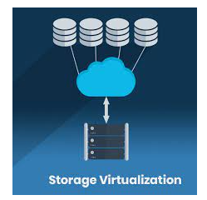
Module-4 (Storage Virtualization) – 8 Hrs
Content-Addressed Storage(CAS)- Types, Features and Benefits, Architecture - Object Storage and Retrieval in CAS- CAS Examples- Concepts in Practice: EMC Center- Storage Virtualization- Forms of Virtualization- SNIA Storage Virtualization- Configurations, Challenges and Types.

Slide 9

Module-5 (Business Continuity (BC)) – 8 Hrs
Introduction to Business Continuity- Backup and Recovery - Local Replication- Remote Replication

Slide 10

Module-6 (Storage Security and Management) – 7 Hrs
Securing the Storage Infrastructure- Security Framework- Security Domains - Implementations in Storage Networking - Managing the Storage Infrastructure-Storage Management Monitoring, Activities and Challenges

Slide 11
Resources for the Course - Books
Text Books:
EMC Education Services, “Information Storage and Management”, 2nd Edition,Wiley, 2012.
Reference Books:
David R Matthews, “Electronically Stored Information”, 2nd Edition, CRC Press, 2017.
Hubbert, “Data Center Storage: Cost-Effective Strategies, Implementation, and Management”, CRC Press,2nd Edition,2016
Nigel Poulton, “Data Storage Networking: Real World Skills for the CompTIA Storage + Certification and Beyond”, Wiley Publication, 2014.

Slide 12
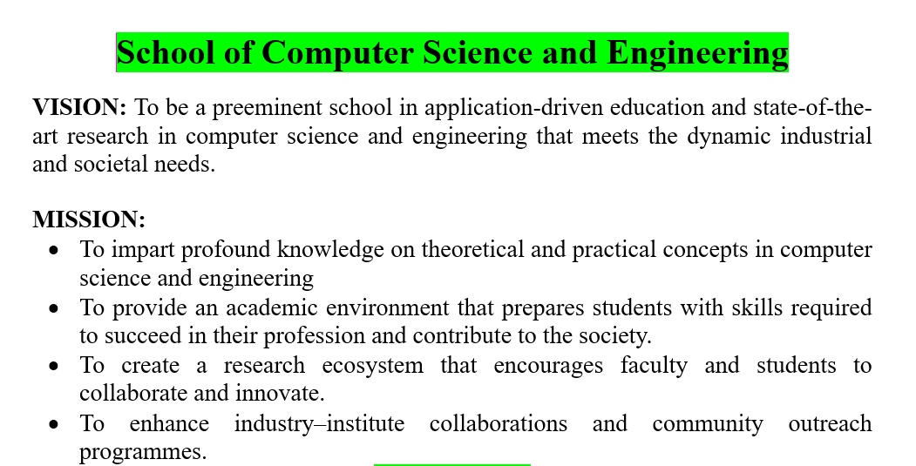

Slide 13
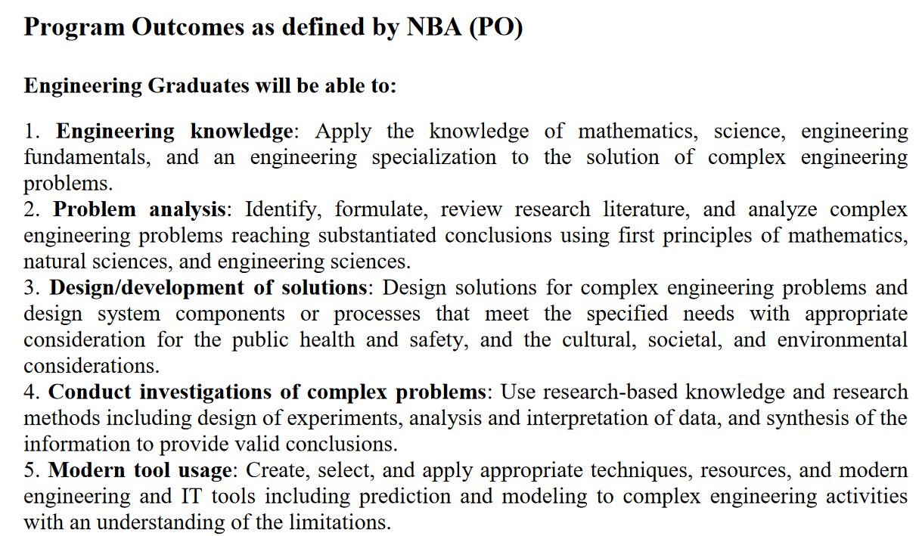

Slide 14
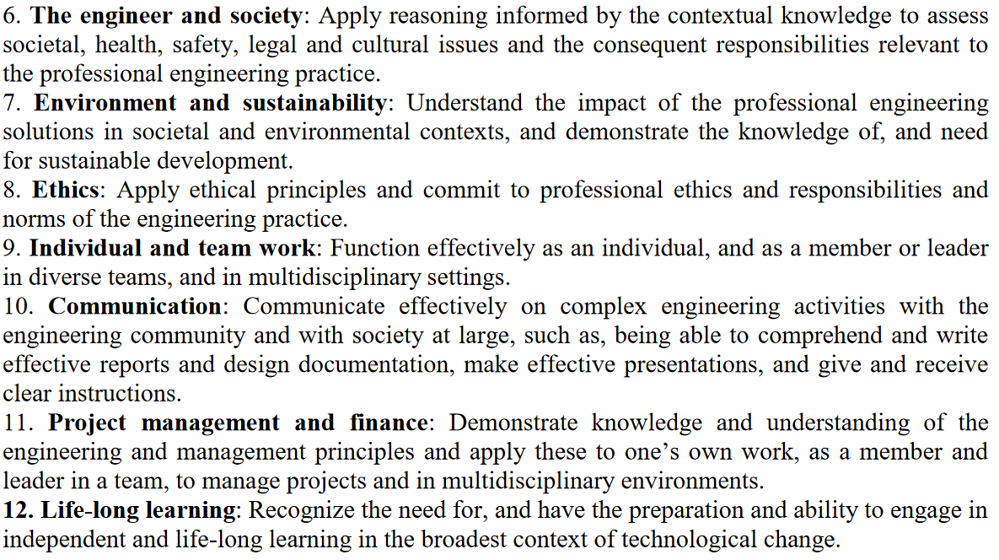

Slide 15

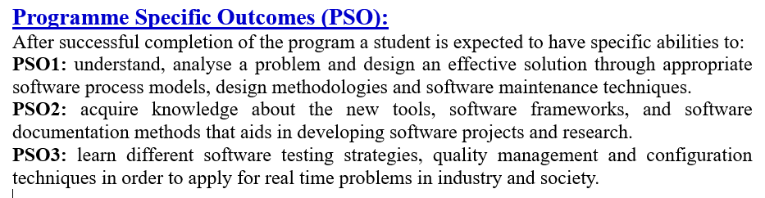

Slide 16
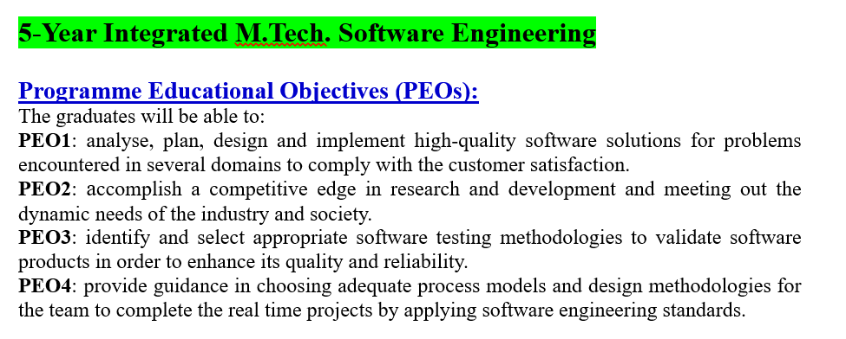

Slide 17
